Slide 1

ECE 593 pre silicion Validation TeAm 3 AXI4_lite Verification using uvm
Professor : Venkatesh PATIL

Slide 2
How the Design Was Chosen and Developed
This project implements an AXI4-Lite slave design, following the protocol as defined in the official AMBA AXI4-Lite specification by ARM. 🔗 AXI4-Lite Reference – ARM AMBA Specification
The Design Under Test (DUT) is a 4-register, memory-mapped slave module supporting both read and write operations, including byte-wise write via WSTRB.
The testbench acts as the AXI master, generating transactions and applying them to the slave (DUT) for verification.
Design logic, protocol handshaking, and internal register behavior were built in RTL (SystemVerilog) and were validated using:
Class-based testbench
UVM-based testbench for modularity, reuse, and coverage
Reference sources used during development:
ARM AXI4-Lite documentation
ChatGPT (OpenAI) for debug suggestions, coverage modeling tips

Slide 3
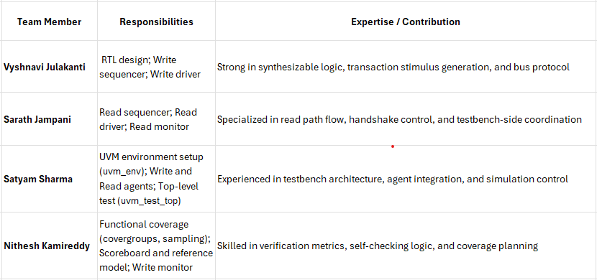
team members and contribution
Contributors Acknowledged: All team members equally contributed to implementation, integration, and documentation across various verification phases.

Slide 4
AXI DESIGN Write & READ Channel handshaking
Channel | Signal | Dir | Description
Address | AWVALID | Input | Master indicates valid write address
 | AWREADY | Output | Slave ready to accept write address
Data | WVALID | Input | Master indicates valid write data
 | WREADY | Output | Slave ready to accept write data
Response | BVALID | Output | Slave response is valid (Write complete)
 | BREADY | Input | Master ready to accept response
Channel | Signal | Dir | Description
Address | ARVALID | Input | Master provides read address
 | ARREADY | Output | Slave accepts read address
Data | RVALID | Output | Slave provides valid read data
 | RREADY | Input | Master ready to receive data
 | RDATA | Output | Read data from register file

Slide 5
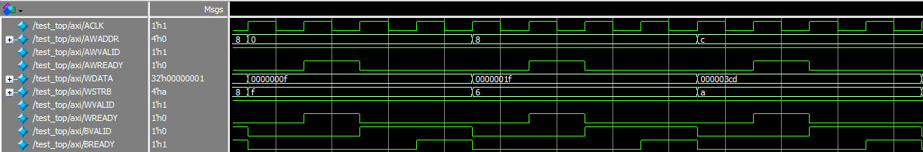
Read & write channel output

Slide 6

Strobe Signal & Registers accessing
Address Selection Logic (AXI4-Lite)
AXI4-Lite slave supports 4 aligned addresses:
0x00, 0x04, 0x08, 0x0C → each maps to a 32-bit register.
Address decoding:
Reg file [AWADDR[3:2]] // Word address: 0,1,2,3
Enforces 4-byte alignment (ADDR[1:0] == 2'b00)
WSTRB (Strobe) Logic – Byte Write Control
WSTRB: 4-bit signal used for byte-enable control on writes.
Each bit corresponds to a byte in the 32-bit WDATA:
WSTRB[0] → byte 0 (WDATA[7:0])
WSTRB[1] → byte 1 (WDATA[15:8])
WSTRB[2] → byte 2 (WDATA[23:16])
WSTRB[3] → byte 3 (WDATA[31:24])

Slide 7
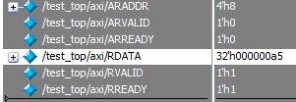
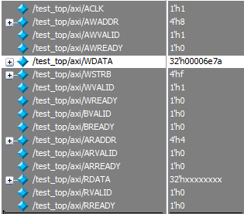
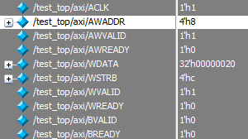
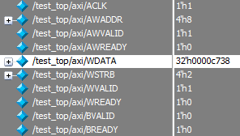
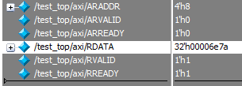
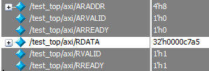
StrOBE SIGNAL VERIFICATION

Slide 8
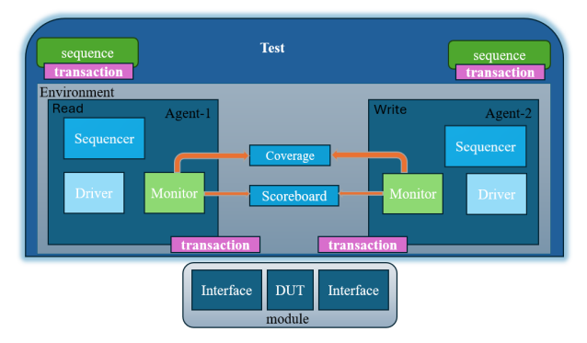
Verification Environment for AXi4lite
UVM testbench topology:
# --------------------------------------------------------------
# Name Type Size Value
# --------------------------------------------------------------
# uvm_test_top axi_test - @472
# env axi_env - @479
# coverage axi_coverage - @515
# analysis_imp uvm_analysis_imp - @522
# ragent read_agent - @493
# driver read_driver - @546
# rsp_port uvm_analysis_port - @561
# seq_item_port uvm_seq_item_pull_port - @553
# monitor read_monitor - @531
# ap uvm_analysis_port - @538
# sequencer read_sequencer - @569
# rsp_export uvm_analysis_export - @576
# seq_item_export uvm_seq_item_pull_imp - @670
# arbitration_queue array 0 -
# lock_queue array 0 -
# num_last_reqs integral 32 'd1
# num_last_rsps integral 32 'd1
# scoreboard axi_scoreboard - @500
# sb_imp uvm_analysis_imp - @507
# wagent write_agent - @486
# driver write_driver - @701
# rsp_port uvm_analysis_port - @716
# seq_item_port uvm_seq_item_pull_port - @708
# monitor write_monitor - @686
# ap uvm_analysis_port - @693
# sequencer write_sequencer - @724
# rsp_export uvm_analysis_export - @731
# seq_item_export uvm_seq_item_pull_imp - @825
# arbitration_queue array 0 -
# lock_queue array 0 -
# num_last_reqs integral 32 'd1
# num_last_rsps integral 32 'd1
# --------------------------------------------------------------

Slide 9
Predictor in Scoreboard:
Scoreboard – Functional Check with Golden Reference
A golden reference model is implemented inside the scoreboard to mimic the DUT’s memory.
During write transactions:
The scoreboard updates its internal memory model using predicted transactions.
During read transactions:
It fetches data from the predicted memory at the requested address.
Compares this value with the actual RDATA received from the DUT.
UVM_INFO write_driver.sv(98) @ 7035000: uvm_test_top.env.wagent.driver [uvm_test_top.env.wagent.driver] [WRITE_TXN] Addr=0xc | STRB=0b0100 | Data=0x0000032a
# UVM_INFO read_monitor.sv(37) @ 7045000: uvm_test_top.env.ragent.monitor [uvm_test_top.env.ragent.monitor] [READ_MON] Captured Read Transaction | Addr=0x8
# UVM_INFO scoreboard.sv(39) @ 7045000: uvm_test_top.env.scoreboard [uvm_test_top.env.scoreboard] [SCOREBOARD] PASS | Addr=0x8 | Data=0x00000099
# UVM_INFO write_driver.sv(98) @ 7075000: uvm_test_top.env.wagent.driver [uvm_test_top.env.wagent.driver] [WRITE_TXN] Addr=0xc | STRB=0b1000 | Data=0x0000f0f2
# UVM_INFO read_monitor.sv(37) @ 7095000: uvm_test_top.env.ragent.monitor [uvm_test_top.env.ragent.monitor] [READ_MON] Captured Read Transaction | Addr=0xc
# UVM_INFO scoreboard.sv(39) @ 7095000: uvm_test_top.env.scoreboard [uvm_test_top.env.scoreboard] [SCOREBOARD] PASS | Addr=0xc | Data=0x0000000d

Slide 10
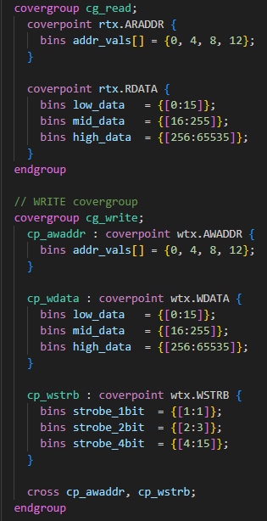
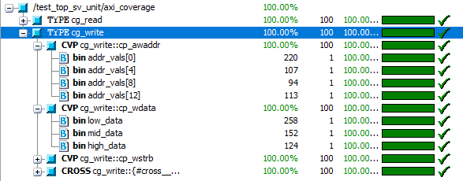
Functional coverage :
Write and Read Monitors send sampled transactions via their analysis ports.
These are received by a child class derived from uvm_subscriber, which contains a covergroup.
The write() method of the subscriber samples each transaction for coverage analysis.
Functional coverage ensures we hit all meaningful combinations of stimulus.
Constrained random testing
Directed toward targeted bins (e.g., address, strobe, data ranges)
Confirms the quality and completeness of the testbench stimuli.

Slide 11
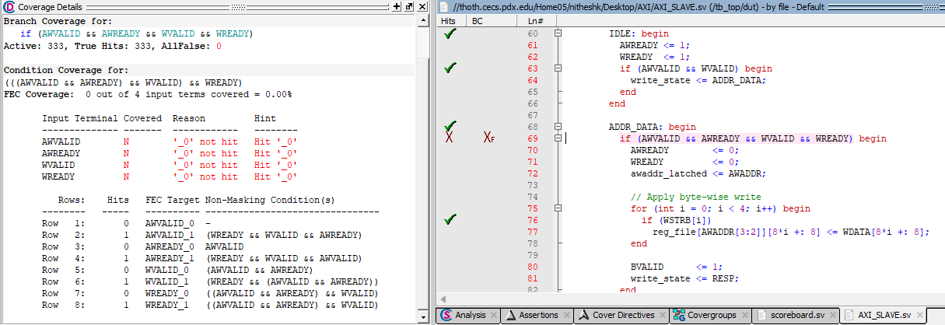
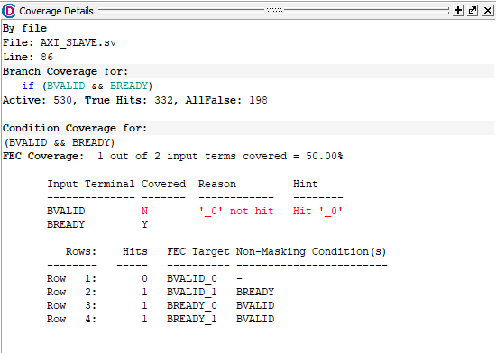
Code Coverage:
Code Coverage Gaps – Branch & Condition
📌 From Line 86: if (BVALID && BREADY)
Branch Coverage: Only 3 scenarios covered.
Missing Case: BVALID = 0 never occurred.
Reason: In RTL, BVALID is asserted only when a write transaction completes. It's never deasserted unless BREADY is high — this limits toggling.
📌 From Line 69: if (AWVALID && AWREADY && WVALID && WREADY)
Branch Coverage: 0% condition coverage – none of the 4 terms reached '0'.
Reason: RTL assumes all signals are HIGH simultaneously for write to proceed.
Design Limitation: Prevents partial handshaking paths (e.g., AWVALID=1, WVALID=0) from being evaluated.

Slide 12
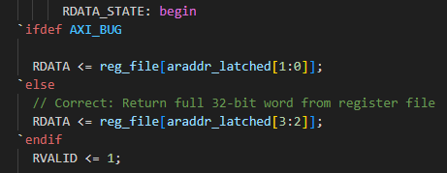
Bug injection & analysis
Bug Injection – Read Mismatch Analysis
A functional bug was intentionally injected in the read data path:
In RDATA_STATE, address decoding uses LSB bits
RDATA <= reg_file[araddr_latched[1:0]]; // BUG: Always maps to addr 0–3
This causes incorrect data fetch for any address ≠ 0x0, leading to:
Read mismatches at 0x04, 0x08, 0x0C
Only address 0x00 fetches correct data
UVM_INFO write_driver.sv(98) @ 2995000: uvm_test_top.env.wagent.driver [uvm_test_top.env.wagent.driver] [WRITE_TXN] Addr=0x0 | STRB=0b1111 | Data=0x000000c9
# UVM_INFO read_monitor.sv(37) @ 2995000: uvm_test_top.env.ragent.monitor [uvm_test_top.env.ragent.monitor] [READ_MON] Captured Read Transaction | Addr=0x0
# UVM_INFO scoreboard.sv(39) @ 2995000: uvm_test_top.env.scoreboard [uvm_test_top.env.scoreboard] [SCOREBOARD] PASS | Addr=0x0 | Data=0x00000001
# UVM_INFO write_driver.sv(98) @ 3035000: uvm_test_top.env.wagent.driver [uvm_test_top.env.wagent.driver] [WRITE_TXN] Addr=0x8 | STRB=0b0001 | Data=0x000037a7
# UVM_INFO read_monitor.sv(37) @ 3045000: uvm_test_top.env.ragent.monitor [uvm_test_top.env.ragent.monitor] [READ_MON] Captured Read Transaction | Addr=0xc
# UVM_ERROR scoreboard.sv(36) @ 3045000: uvm_test_top.env.scoreboard [SCOREBOARD] [FAIL] Addr=0xc | Expected=0x00007ac1 | Actual=0x000000c9
# UVM_INFO write_driver.sv(98) @ 3075000: uvm_test_top.env.wagent.driver [uvm_test_top.env.wagent.driver] [WRITE_TXN] Addr=0xc | STRB=0b1110 | Data=0x00000023
# UVM_INFO read_monitor.sv(37) @ 3095000: uvm_test_top.env.ragent.monitor [uvm_test_top.env.ragent.monitor] [READ_MON] Captured Read Transaction | Addr=0x8
# UVM_ERROR scoreboard.sv(36) @ 3095000: uvm_test_top.env.scoreboard [SCOREBOARD] [FAIL] Addr=0x8 | Expected=0x000000a7 | Actual=0x000000c9

